Slide 1
Computing Fundamentals
Lecture 2B: Microprocessors, SoC and ARM

Slide 2
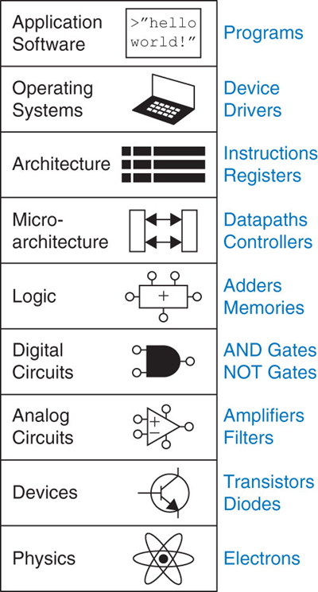
Microprocessors, SoC and ARM
Microprocessor
Microcontroller
ARM
RISC Architecture
Fixed Instruction Size
Registers
Reduce Complexity of Instruction Set
Load/Store Architecture
One Instruction per Cycle
Fetch Execute Cycle
Pipelining

Slide 3
Microprocessor
The invention of the transistor and the Integrated Circuit (IC) provided a means to put a Central Processing Unit (CPU) on a printed circuit board. Very Large Scale Integration (VLSI) made it possible to put the entire CPU on a single IC chip, called a microprocessor. For example the x86 family produced by Intel. Historically microprocessors did not contain RAM, ROM or I/O ports. So these were connected externally by the use of Buses.
General Purpose Microprocessor
(CPU)
RAM
ROM
I/O Port
Timer
Serial COM Port
Buses

Slide 4
Microcontroller
The next step was to put all the different parts of a system, including CPU, RAM, ROM I/O ports etc., on a single IC chip called a microcontroller or SoC (System on Chip), also known as a MCU (Micro Controller Unit).
Microcontroller
General Purpose Microprocessor
(CPU)
RAM
ROM
I/O Port
Timer
Serial COM Port
Buses
Simplified View of the Internal Parts of a SoC

Slide 5
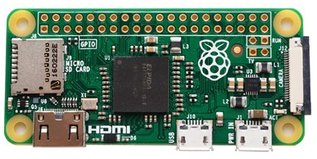
Raspberry Pi Zero
BCM2835 manufactured by Broadcom Limited, but was designed by ARM. Broadcom BCM2835 contains an ARM1176JZFS (ARM11 using an ARMv6 architecture core) with floating point.
40-pin header GPIO
Broadcom BCM2835 SoC
Runs at up to 1GHz
Dual Core VideoCore IV GPU
512MB Onboard RAM

Slide 6

ARM
‘Every day our thousands of partners embed more than 45 million Arm-based chips in products … ‘
https://www.arm.com/company
Accessed 7th Feb 2018

Slide 7
ARM History
1982 – Acorn produce BBC micro
1985 – Acorn Computer Group develop the ARMv1, world’s first commercial RISC processor. 25,000 transistors, 4MHz.
1989 – Acorn introduce ARMv3. 25MHz and 4KB cache.
1990 – Advanced RISC Machines (ARM) spins out of Acorn. Collaboration with Apple Computers, Newton PDA. VLSI becomes first licensee.
1991 – ARM introduction its first embeddable RISC core, the ARM6 solution using ARMv3 architecture.
2001 – ARM has 77% of 32-bit embedded RISC microprocessor market. Announce ARMv6 architecture.
2002 – ARM reach one billion microprocessor cores
2007 – 5 Billionth ARM processor shipped
2008 – ARM announces 10 Billionth processor shipped
Notes:
Sophie Wilson

Slide 8
RISC Architecture in ARM
There are basically three ways available to a microprocessor designer to increase the processing power of a CPU:
Increase the clock frequency of the chip; increases power consumption and more heat to dissipate.
Use Harvard Architecture; increases the number of buses, separates code and data.
Change architecture of CPU to a Reduced Instruction Set Computer architecture, as opposed to a Complex Instruction Set Computer architecture.

Slide 9
Features of RISC
Fixed instruction size; ARMv6 uses 4-byte instructions but not all 32 bits are always needed.
A large number of registers; ARMv6 has 16 registers, some have special functions.
Reduced complexity of instruction set: only has basic instructions such as ADD, SUB, MUL, LOAD, STORE, AND, ORR, EOR, B etc. (The down side is it makes the task of programming in assembly language more difficult.)
Uses load/store architecture: there is no way of performing arithmetic and logic operations on values in memory, must first bring both operands into the registers inside the CPU.
Nearly all instructions are executed within one clock cycle.
Does not use microinstructions (microcode). The implementation of microcode inside CISC CPU employs more than 40-60% of its transistors – increasing power consumption

Slide 10
Fixed instruction size RISC feature 1
Word
Half Word |  |  |  |  |  |  |  |  |  |  |  |  |  |  |  | Half Word
Byte3 |  |  |  |  |  |  |  | Byte2 |  |  |  |  |  |  |  | Byte1 |  |  |  |  |  |  |  | Byte 0
31 | 30 | 29 | 28 | 27 | 26 | 25 | 24 | 23 | 22 | 21 | 20 | 19 | 18 | 17 | 16 | 15 | 14 | 13 | 12 | 11 | 10 | 9 | 8 | 7 | 6 | 5 | 4 | 3 | 2 | 1 | 0
Word size is 32 bits
Half-words are 16 bits wide.
Words are aligned on 4-byte boundaries
Half words are aligned on even byte boundaries.

Slide 11
Fixed instruction size RISC feature 1
Memory Address Value
0x000B | 0xE0
0x000A | 0x80
0x0009 | 0x20
0x0008 | 0x01
0x0007 | 0xE3 |  |  | 0xE3A00010
0x0006 | 0xA0
0x0005 | 0x10 |  | 0xE3 | 0xA0 | 0x00 | 0x10
0x0004 | 0x0A
0x0003 | 0xE3
0x0002 | 0xA0
0x0001 | 0x00
0x0000 | 0x10
Words are normally stored in "little endian" format.
The low-order byte is stored at the lowest byte address and the high-order byte is stored at the highest byte address.
ARM processors can be switched to "big endian"
Little Endian
CPU
N.B. Big Endian 0x1000A0E3

Slide 12
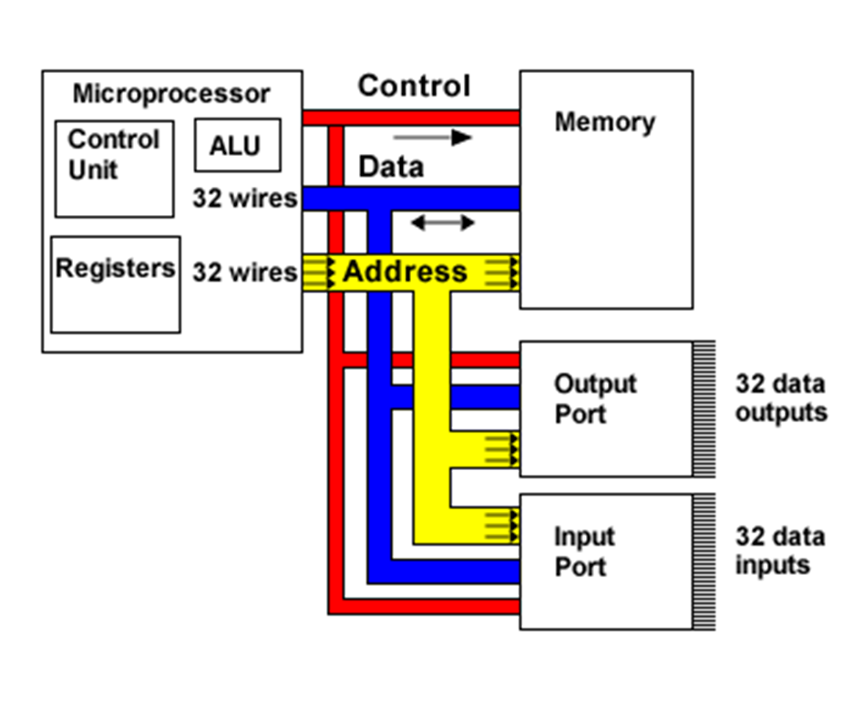
Registers RISC feature 2
The CPU contains:-
An Arithmetic/Logic unit, which performs mathematical and logical computations.
A Control Unit that manages the execution of instructions.
Many Registers that are used as temporary storage.
Abstract system architecture

Slide 13
Registers RISC feature 2
R0 |  |  |  | ARM Operating Modes
R1 |  |  |  | User | Normal execution state
R2 |  |  |  | FIQ | Fast Interrupt mode
R3 |  |  |  | IRQ | Interrupt mode
R4 |  |  |  | SVC | Supervisor mode (software int.)
R5 |  |  |  | ABT | Memory access failure
R6 |  |  |  | UND | Undefined instruction executed
R7
R8 |  | R8
R9 |  | R9
R10 |  | R10
R11 |  | R11
R12 |  | R12
R13=SP |  | R13=SP |  | R13=SP |  | R13=SP |  | R13=SP |  | R13=SP
R14=LR |  | R14=LR |  | R14=LR |  | R14=LR |  | R14=LR |  | R14=LR
R15=PC
CPSR |  | SPSR |  | SPSR |  | SPSR |  | SPSR |  | SPSR
User |  | FIQ |  | IRQ |  | SVC |  | ABT |  | UND
SP Stack Pointer, LR Link Register, PC Program Counter,
CPSR Current Program Status Register

Slide 14
Current Program Status Register RISC feature 2
31 | 30 | 29 | 28 |  | 7 | 6 | 5 | 4 |  |  | 0
N | Z | C | V |  | I | F | T
Condition code flags
Interrupt disable bits
Processor mode
Thumb operation
N (Negative) flag – set to 1 if result is considered negative; otherwise 0.
Z (Zero) flag – set to 1 when the result of an instruction is zero. Also set when two compared operands are equal.
C (Carry) flag – set to 1 if an addition generates a carry or a subtraction generates a borrow.
V (oVerflow) flag – set to 1 when an overflow occurs.

Slide 15
Reduced Complexity RISC feature 3
Arithmetic Operation Destination, Operand 1, Operand 2
(Instruction Destination, Source1, Source2)
Example: ADD R0, R1, R2 ; R0 ⇐ R1 + R2
R1 and R2 are the source registers containing the input operands, R0 is the destination register where the result is stored.
The destination register can be the same as one of the source registers
ADD R0, R0, R1 is legal and means add the values in R0 and R1 together and place the result in R0.
This ADD instruction can be used on both unsigned and 2's complement signed numbers.
It may produce a carry or overflow signal and set the corresponding bits in the CPSR, but such signals are ignored by default.

Slide 16
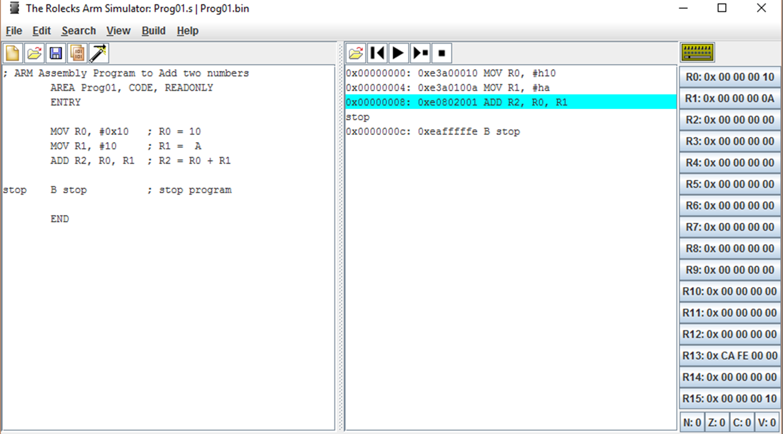
ARM Simulator
The ARM simulator shows that the instruction ADD R2, R0, R1 is stored as 0xE0802001
The ARM simulator is about to execute the instruction ADD R2, R0, R1 at 0x00000008
The Program Counter holds address 0x00000010

Slide 17
Load/Store Architecture RISC feature 4
Arithmetic and logic operations on operands held in the registers inside the CPU.
R0
R1
R2
. . . .
R15 PC
ADD R2, R0, R1 (ADD Rd, Rn, Rm)
R2 ⇐ R0 + R1 (Rd ⇐ Rn + Rm)
32-bit data
32-bit data
32-bit data
Status Flags
CPSR (Status Flags)
Status Flags
ALU

Slide 18
Load/Store Architecture RISC feature 4
Only load and store instructions access memory
LDR R0, [R1]
R0 receives the value held in the memory address pointed to by R1
STR R0, [R1]
The memory location pointed to by R1 receives the value held in R0
All other instructions are register-to-register
This speeds up overall operation as register accesses are much faster than memory accesses.

Slide 19
Machine Instruction and Clock Cycles RISC feature 5
Everything that goes on inside a CPU is synchronised to a pulse generator called the clock. Each pulse from the clock triggers a clock cycle.
A 80MHz CPU implies an instruction cycle is 1/80,000,000 s = 0.0125 ms (microseconds) = 12.5 ns (nanoseconds)
Instructions |  | Time in clock cycles ⇨
 | 1
 | 2
 | 3
 | 4
Instructions |  | Time in clock cycles ⇨
 | 1
 | 2
 | 3
 | 4
 | 5
 | 6
RISC CPU goal, one instruction per cycle
CISC CPU using microinstructions

Slide 20
Fetch Execute Cycle
A CPU executes a single instruction in a number of steps, for example:
Fetch the instruction (IF)
Decode the instruction (ID)
Execute the instruction (EX)
Write back any changes made by the instruction (WB)
If each step took the same length of time, it would be possible to do them in parallel. The overlapping of these steps is common place and is used in ARM processors.

Slide 21
Pipelining (Simplified ARM11 Pipeline)
Overlapping instruction execution, as the 1st instruction is being executed, the 2nd is being decoded and the 3rd is being fetched
Instructions |  | Time in clock cycles ⇨
 | 1 | Fetch | Decode | Execute | Write
 | 2 |  | Fetch | Decode | Execute | Write
 | 3 |  |  | Fetch | Decode | Execute | Write
 | 4 |  |  |  | Fetch | Decode | Execute | Write
 | 5 |  |  |  |  | Fetch | Decode | Execute | Write
 | 6 |  |  |  |  |  | Fetch | Decode | Execute | Write
The PC holds the address of the instruction to be fetched not the one to be executed.

Slide 22
Pipelining – Program Counter
Contents | Action
PC | Next instruction to fetch
PC – 4 | Instruction to be decoded
PC – 8 | Instruction to execute
PC – 12 | Instruction previously executed
Why in steps of 4?
Each instruction is 32 bits or 4 bytes.
Each address holds a byte.

Slide 23
Pipelining
Pipelining allows instructions to overlap in execution
The cycle is split into a number of stages (pipe stages). To complete execution an instruction uses all stages. But the next instruction can start once the previous instruction has completed the first pipe stage
Pipelining improves instruction throughput rather than instruction execution time (latency)
Historically 3 and 4-stage pipelines were state of the art. The ARM11 CPU has an 8-stage instruction pipeline, current Intel processes have 20+ stages.

Slide 24
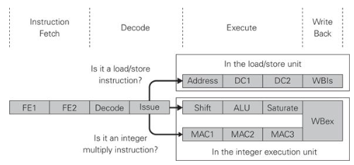
ARM11 8-stage Pipeline
For information and completeness
Load/store path
Integer execution path
Multiply-accumulate path
Source: Upton, E. et al, Learning Computer Architecture with Raspberry Pi, Wiley (2016)
First four stages are identical.
FE1: address requested, instruction fetched
FE2: branch prediction
Decode: instruction decoded
Issue: registers read, instruction issued

Slide 25
Pipeline – 3 Possible Paths
For information and completeness
Load/store path:
Address: generates addresses used to access memory
DC1: 1st stage address processed by the data cache logic
DC2: 2nd stage address processed by the data cache logic
WBls: write back and changes made to memory locations
Integer execution path:
Shift: any required shift operation performed
ALU: any required integer operation performed in ALU
Saturate: results forced to fall within range
WBex: register data is written back
Multiply-accumulate path:
MAC1: 1st stage for execution of multiplication instructions
MAC2: 2nd stage for execution of multiplication instructions
MAC3: 3rd stage for execution of multiplication instructions

Slide 26
Pipeline Stalling
The objective is to move instruction through pipeline continuously and at a uniform rate. Delays are called pipeline stalls.
The smooth flow of instructions can be disrupted by “pipeline hazards”. Three categories of hazards:
Control hazards: caused by branch instructions
Data hazards: caused by data dependency between instructions
Structural hazards: caused by resource conflicts
The general approach is for the instruction decode logic to identify when a hazard is about to occur. This is done by a piece of hardware known as an interlock. It inserts a ‘bubble’ into the pipeline ahead of the problematic instruction.

Slide 27
Control Hazards
Branches can cause hazards because the address of the next instruction is not known until the branch instruction is executed.
A conditional branch instruction, (where the logic to determine if a branch is taken is located in the EX stage), may branch away from instructions that have already been fetched and decoded.
Historically, abandon instructions in the pipeline and fetch new ones.
Branch prediction: predict which destination will be taken passed on history.
Speculative execution: execute the next instruction anyway, hope that instruction will be able to use the results.

Slide 28
Data Hazards
Data hazards occur when a value required in a register is not valid because a previous instruction has not yet updated it. For example, the resultant value from one instruction may be needed as an input by the next instruction in the pipeline.
This didn’t happen in the simple 3-stage pipeline, as reading the register, computing the result and writing back all happened in the EX stage.
Instead of waiting (pipeline stall) for a value in a register to become available, pipeline registers are used. So, for example, results are fed back from EX stages backwards into the ALU input for instance.

Slide 29
Structural Hazards
Resource conflicts occur when two instructions in the pipeline require access to the same resource at the same time. For example, both instructions require access to external memory via cache system. An IF stage reading instruction and an EX stage writing instruction.
One of the instructions could be given priority over the other.
Some conflicts may be resolved by splitting the cache into parts, one for data and one for instructions. This is known as the modified Harvard Architecture, as in ARM11 CPUs.

